Slide 1

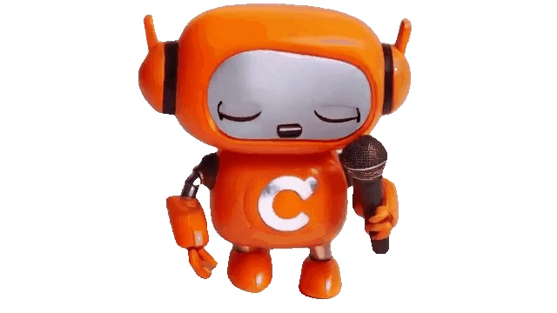
Colloquium A Career Guidance Support AI system Web Project
Soham Chatterjee (2348062)
Ritwika Das Gupta (2348049)
Sayantan Ray (2348057)
Under the guidance of Dr. Apash Roy

Slide 2
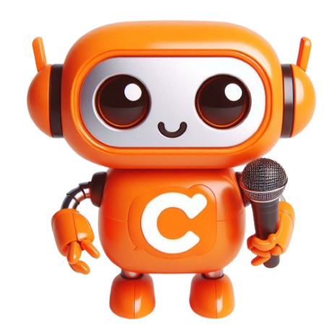
Please introduce your project
In today's dynamic job market, individuals often face challenges in navigating career paths and making informed decisions regarding their professional development.
The overwhelming amount of available information makes it difficult for users to find relevant and personalized advice, leading to suboptimal career choices and job dissatisfaction.
To address these challenges, we propose an intelligent, AI-driven career guidance platform that offers personalized, data-driven insights and recommendations.

Slide 3
What are the objectives?
Personalization:
Provide customized career guidance based on individual user profiles, preferences, and goals.
Interview Preparation:
Use an AI-driven interview bot to conduct mock interviews tailored to the user’s resume and career goals. Offer feedback and grading on interview performance, if feasible, to help users improve their skills.
Multimodal Support:
Implement a chatbot for both text and audio queries to provide comprehensive support and enhance user engagement.
Research Paper Recommendations:
Utilize machine learning models to recommend relevant research papers based on user queries, supporting continuous learning and professional development.

Slide 4
What are the objectives?
Multilingual Chatbot : Ask in your Lingo . We will build a chatbot specific to career related queries that is capable of answering in every language. (This project scope includes 5 languages.)
Other Modules : We also plan to create other learning support modules such as aptitude preparation, career personality test, a warmup session to interview and Coursera course recommendation system etc to make the website scope wiser.

Slide 5
What are the limitations of the existing systems?
Jobscan:
Uses AI to optimize resumes for Applicant Tracking Systems (ATS).
Provides insights on job descriptions and keywords.
Tailors resumes for specific roles.
CareerBuilder:
Offers a career change program with personalized mentoring.
Provides job placement assistance and career coaching.
Limitations of Existing Systems:
Jobscan: Focuses solely on resume tracking and related functionalities.
CareerBuilder: Primarily offers mentoring and job placement assistance,
with limited scope

Slide 6
What are the limitations of the existing systems?
Year of Implementation | AI Name | Techniques/Algorithm | Gap or Drawback
2018 | Pymetrics | Neuroscience-based Games, ML | Limited scope of assessment, potential biases in games
2019 | HireVue | Video Interview Analysis, AI, ML | Potential bias in AI algorithms, privacy concerns
2020 | MyInterview | AI Video Analysis, NLP, ML | Limited language support, privacy and data security issues
2021 | Talview | Behavioral Insights, AI, ML | High dependency on video quality, potential bias issues
2022 | InterviewStream | Video Interviewing, AI Analysis | Requires strong internet connection, potential bias in evaluations
2023 | Vervoe | Skill Assessment, AI Scoring | May not cover all skill types accurately, potential biases
2018 | JobPal | Chatbot, NLP, ML | Limited conversation complexity, potential language support issues
2023 | Iris.ai | AI, NLP, Research Paper Recommendation | May struggle with niche topics, requires large data sets for accuracy

Slide 7
Then what is the uniqueness of your project?
Our system offers a module for document scanning and answering related questions, but it also integrates other modules, providing a more wider career support experience beyond just resumes.
AI-generated mock interview practice.
Multilingual for broader scope.
Grading and feed back.
Research paper and material recommendations including online courses.

Slide 8
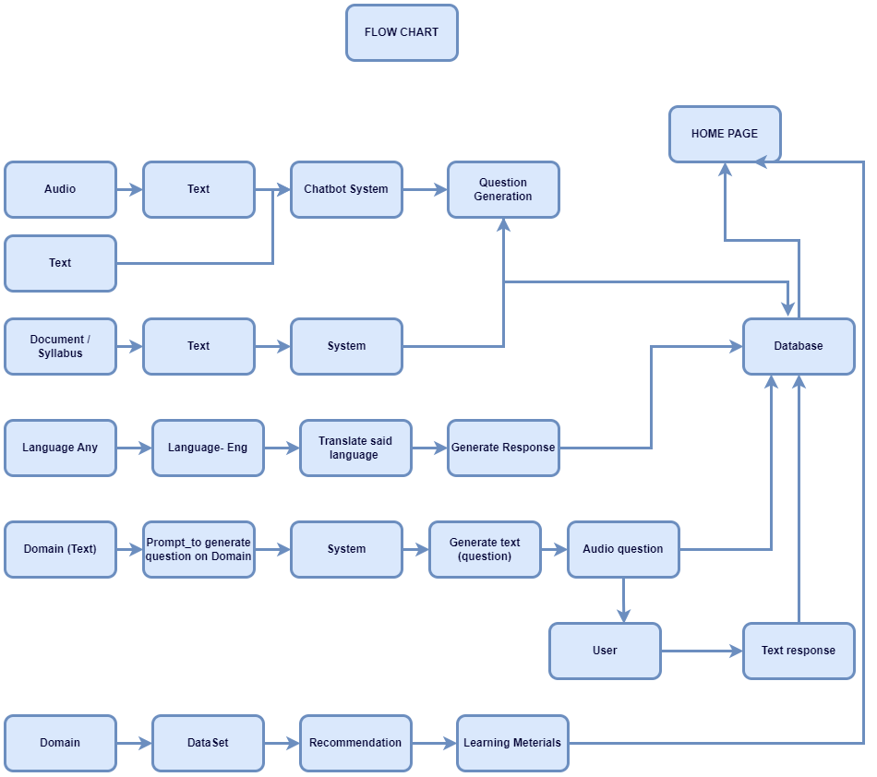
Explain the flow of your project.

Slide 9
Models Used for the Chatbot
For audio transcription facebook/wav2vec2-large-960h-lv60-self
The large model pretrained and fine-tuned on 960 hours of Libri-Light and Librispeech on 16kHz sampled speech audio. Model was trained with Self-Training objective.
When using the model make sure that your speech input is also sampled at 16Khz.

Slide 10
Models Used for the Chatbot
For text generation microsoft/Phi-3-mini-4k-instruct
The Phi-3-Mini-4K-Instruct is a 3.8B parameters, lightweight, state-of-the-art open model trained with the Phi-3 datasets that includes both synthetic data and the filtered publicly available websites data with a focus on high-quality and reasoning dense properties.
The model belongs to the Phi-3 family with the Mini version in two variants 4K and 128K which is the context length (in tokens) that it can support.

Slide 11
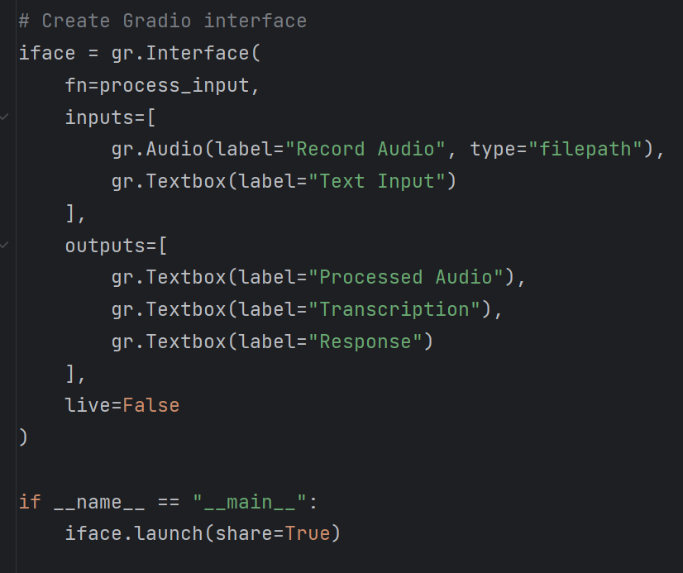
How was the interface made?
The interface was build in gradio which is huggingface tool to build interfaces using large language models.
The code uses live link for interface later we can upload the interface in huggingface spaces to host it.
Here is the interface launch snippet.

Slide 12
0
Models Used for the Document Summariser
Model Name: meta-llama/Llama-2-7b-chat-hf
The LLaMA-2-7B-Chat is a conversational AI model from Meta, featuring 7 billion parameters. It's optimized for generating human-like dialogue, making it ideal for chatbots, virtual assistants, and other interactive applications.
Embedding Model Name: sentence-transformers/all-mpnet-base-v2
The all-mpnet-base-v2 is a high-performance embedding model from the Sentence-Transformers library. It produces dense, semantically rich embeddings suitable for tasks like semantic search, clustering, and text similarity.

Slide 13

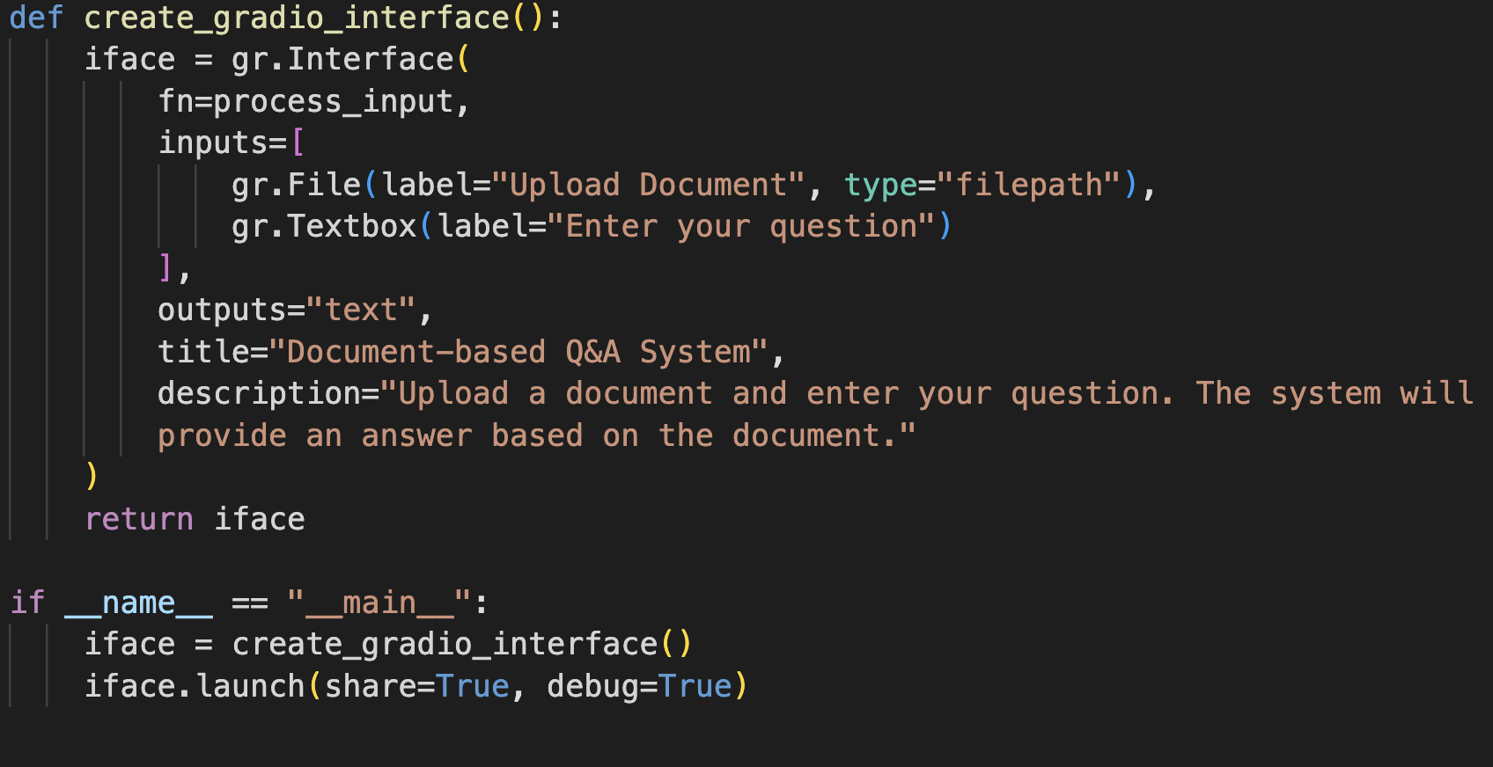
How was the interface made?
The interface was build in gradio which is huggingface tool to build interfaces using large language models.
The code uses live link for interface later we can upload the interface in huggingface spaces to host it.
Here is the interface launch snippet.

Slide 14
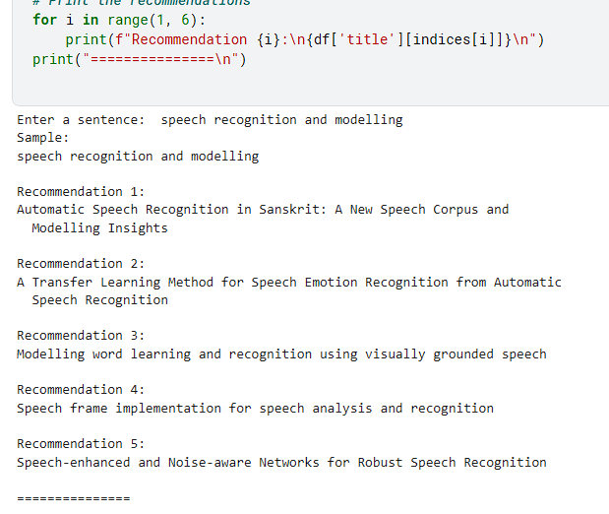
What about the research paper recommendation?

Slide 15


What about the research paper recommendation?

Slide 16
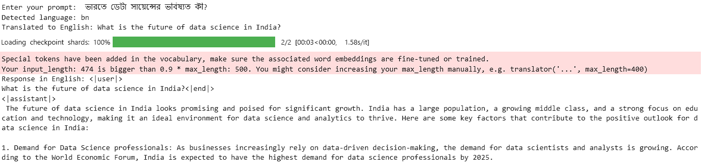
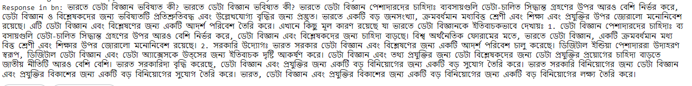
What is the output of your multilingual bot like?

Slide 17

What about the interview bot?
Resume Parsing:
Supported Formats: PDF, DOCX
Tools Used:
Pdf plumber for PDF text extraction
docx2txt for DOCX text extraction
Dynamic Questioning:
Text Generation Model:
Model Used: microsoft/Phi-3.5-mini-instruct
Framework: Hugging Face's Transformers
Capabilities: Generates context-specific interview questions
Follow-Up Questions:
Crafted based on user's responses to simulate realistic interview flow
Technical Aspects:
Text Generation:
Pipeline built using AutoModelForCausalLM and AutoTokenizer
Data Processing:
Regular Expressions (Regex) used for structured text extraction
Gradio Interface: Provides a user-friendly platform for interacting with the bot

Slide 18





Explain the other modules
Course Compass : Online Course Recommender
Using Beautiful soup for web scraping
Content based filtering algorithm to recommend similar courses
Cosine similarity
Aptitude Ace: Aptitude Testing platform
Contains quiz on topics such as maths, probability, vocabulary, time and work,etc
Interview warmup
Inspired from Google interview warmup.
Audio powered interview simulation
Generic questions, critical thinking, situational questions etc.
Time to answer also stored for analysis and dashboard.
Personality Test (Fun element)
Uses Myers Briggs indicator to categorize the inputs of users to major personality types.

Slide 19
Describe your project roles
Soham Chatterjee
Develop Meterial Recommendation using ML algorithms.LLM integration for multilingualchatbot.
Warmups of interview, Backend integration of data stored from interview bot todashboard.Front end of mentioned modules.
Ritwika Dasgupta
Itegration of LLM for audio chatbot, develop its front end– Integration of LLM models for interview bot, develop its front end.Integration ofPersonality test and its front end.
Sayantan Ray
– Develop Aptitude test and its front end. Colaborate with interview bot pdf dataextraction.–
Integrate LLM model for document summerizer, frontend of mentioned modules.

Slide 20
CONCLUSION
The design document outlines a detailed architectural framework and blueprint for the COLLOQUIUM AI-driven career guidance platform.
It covers comprehensive system specifications, including hardware and software requirements.
Intricate internal communications and human-machine interfaces are detailed for seamless platform operation.
Design constraints and system integrity are addressed to ensure a secure, scalable, and efficient platform.
The platform's ability to adapt to future advancements and challenges is emphasized.

Slide 21

UPCOMING TASKS
Integrate all the modules and link it to the Home Page Nav Bar sections
Connect data stored in backend to a dashboard for user’s analysis
The interview bot is incomplete and has to be better functioned. We are trying to make the conversation over speech as well so that it properly simulates an interview.
Making UI of certain components better.

Slide 22
References
R. Pressman, Software Engineering: A Practitioner's Approach, 7th ed. New York, NY, USA: McGraw-Hill, 2010.
I. Sommerville, Software Engineering, 10th ed. Boston, MA, USA: Pearson, 2015.
P. Clements, F. Bachmann, L. Bass, D. Garlan, J. Ivers, R. Little, P. Merson, R. Nord, and J. Stafford, Documenting Software Architectures: Views and Beyond, 2nd ed. Boston, MA, USA: Addison-Wesley, 2010.
B. Bruegge and A. H. Dutoit, Object-Oriented Software Engineering Using UML, Patterns, and Java, 3rd ed. Boston, MA, USA: Pearson, 2010.
•J. Devlin, M. Chang, K. Lee, and K. Toutanova, "BERT: Pre-training of Deep Bidirectional Transformers for Language Understanding," in Proc. of NAACL-HLT, Minneapolis, MN, USA, 2019, pp. 4171-4186.
T. Wolf, L. Debut, V. Sanh, J. Chaumond, C. Delangue, A. Moi, P. Cistac, T. Rault, R. Louf, M. Funtowicz, and J. Brew, "Transformers: State-of-the-Art Natural Language Processing," in Proc. of EMNLP, Online, 2020, pp. 38-45.
Mehta, A. & Simperl, E. (2022). "AI-Assisted Career Guidance: A Systematic Review." IEEE Access, 10, 35390-35404.
Zhao, M., et al. (2021). "Research on personalized recommendation system for career planning based on knowledge graph." Journal of Physics: Conference Series, 1856(1), 012041.
Strohmeier, S. & Piazza, F. (2013). "Domain driven data mining in human resource management: A review of current research." Expert Systems with Applications, 40(7), 2410-2420.
Gupta, P., et al. (2018). "Resume parsing and standardization." In 2018 International Conference on Advances in Computing, Communications and Informatics (ICACCI) (pp. 1477-1483). IEEE.
Van Iddekinge, C. H., et al. (2016). "A meta-analysis of the criterion-related validity of prehire work experience." Personnel Psychology, 69(3), 571-598.
Westman, Stina, et al. "Artificial Intelligence for Career Guidance--Current Requirements and Prospects for the Future." IAFOR Journal of Education 9.4 (2021): 43-62.
Mehraj, Tehseen, and A. Mehraj Baba. "Scrutinizing artificial intelligence based career guidance and counselling systems: an appraisal." International journal of interdisciplinary research and innovations 7.1 (2019): 402-411.
Talib, Abdelmoumen, Mohamed Housni, and Mohamed Radid. "Utilizing M-Technologies for AI-Driven Career Guidance in Morocco: An Innovative Mobile Approach." International Journal of Interactive Mobile Technologies 17.24 (2023).

Slide 23
Colloquium : Thank you. If you have any questions, feel free to ask.

